Slide 1
$tocker
stock market prediction
Using machine learning

Slide 2

Logo

Slide 3
Project Abstract
This is interesting machine learning project in this project we will making one website or software. in this we will plane for the predict the future price of the stock market(normal condition).
in this Project we will using frontend ,backend an as well as the graph plotting using machine learning(ML)

Slide 4
Frontend technologies
HTML
CSS
JS
JQuery
Bootstrap
Flask
Django

Slide 5
Backend technologies
Python(for logic)
Machine Learning(for prediction )
MySQL or Sqlite3(for database)
Algorithms(base of ML)

Slide 6
Features
In this project we will set some advanced level features
like you will trading directly from here
Maintain there portfolio
Expert advice by Some market Expert(to user to stay ,to buy of go for sell)

Slide 7
How project will developed
In this project we will developed one website using HTML, CSS, JS, JQuery , Django and flask this all technologies is used in only for front for web developing and in backend technologies we will use the python for logic and ML for predict the market using graph and for database we will use the my SQL and SQLite for data fetch and data store this way project is developed

Slide 8
Why this project is required and what was earlier
In this project we will create on website or one software in this we will provide the graph of that stock using ml that give user to per second analysis and we will provide some advice from that.
we have some website to give just live price of stock and data and we will think that we just add some more features like user will tread from directly there and also user will get some expert advice form market experts so this is our motto to develop this project.

Slide 9
PMMS Activities

Slide 10
Student Activity Status
Periodic Progress Report
Activity | Submitted | Commented | Reviewed
Periodic Progress Report 1 (PPR 1) | Yes | No | No
Periodic Progress Report 2 (PPR 2) | Yes | No | No
Periodic Progress Report 3 (PPR 3) | Yes | No | No
Periodic Progress Report 4 (PPR 4) | Yes | No | No

Slide 11
Patent Search & Analysis Report
Activity | Submitted | Commented | Reviewed
Patent Search & Analysis Report (PSAR 1) | Yes | No | No
Patent Search & Analysis Report (PSAR 2) | Yes | No | No
Patent Search & Analysis Report (PSAR 3) | Yes | No | No
Patent Search & Analysis Report (PSAR 4) | Yes | No | No
Patent Search & Analysis Report (PSAR 5) | Yes | No | No

Slide 12
Diagrams

Slide 13
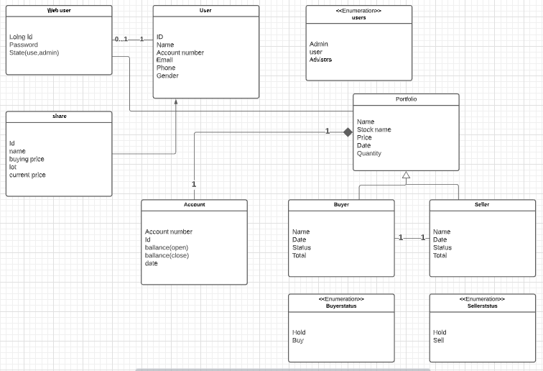
Class Diagram

Slide 14
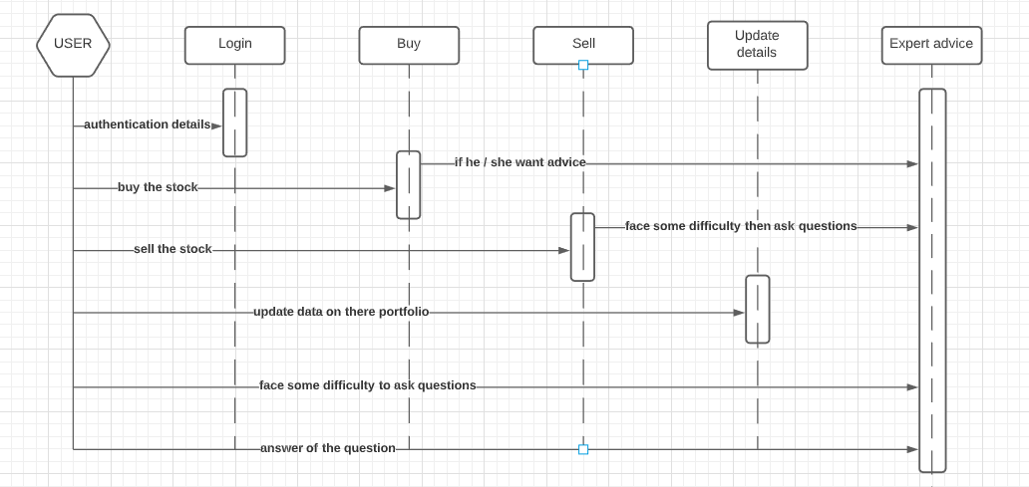
Sequence Diagram

Slide 15
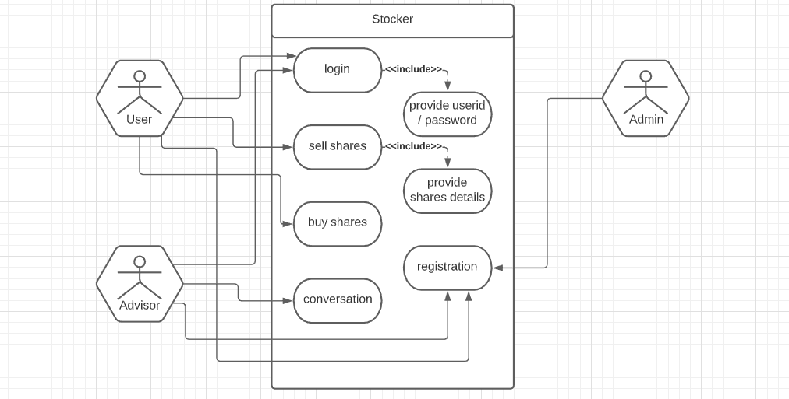
Use case Diagram

Slide 16
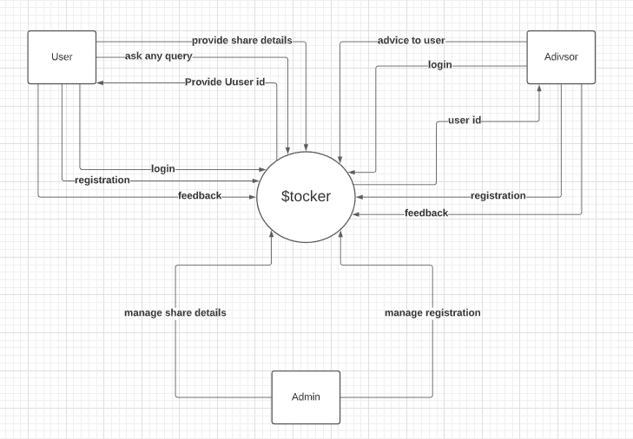
DFD Level-0

Slide 17
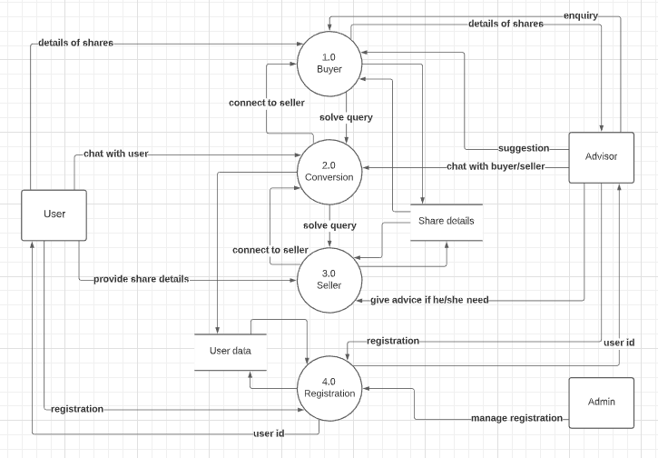
DFD Level-1

Slide 18
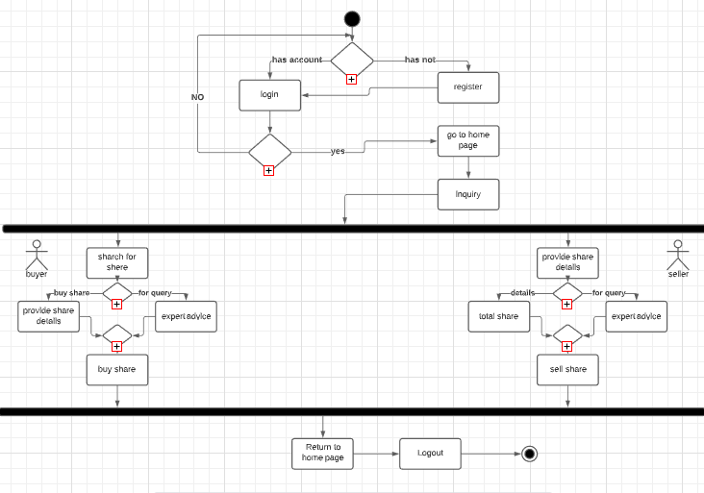
Activity Diagram

Slide 19
Dataset
Details of data set
Date
Open price
High
Low
Closing
Volume

Slide 20
Wireframe

Slide 21
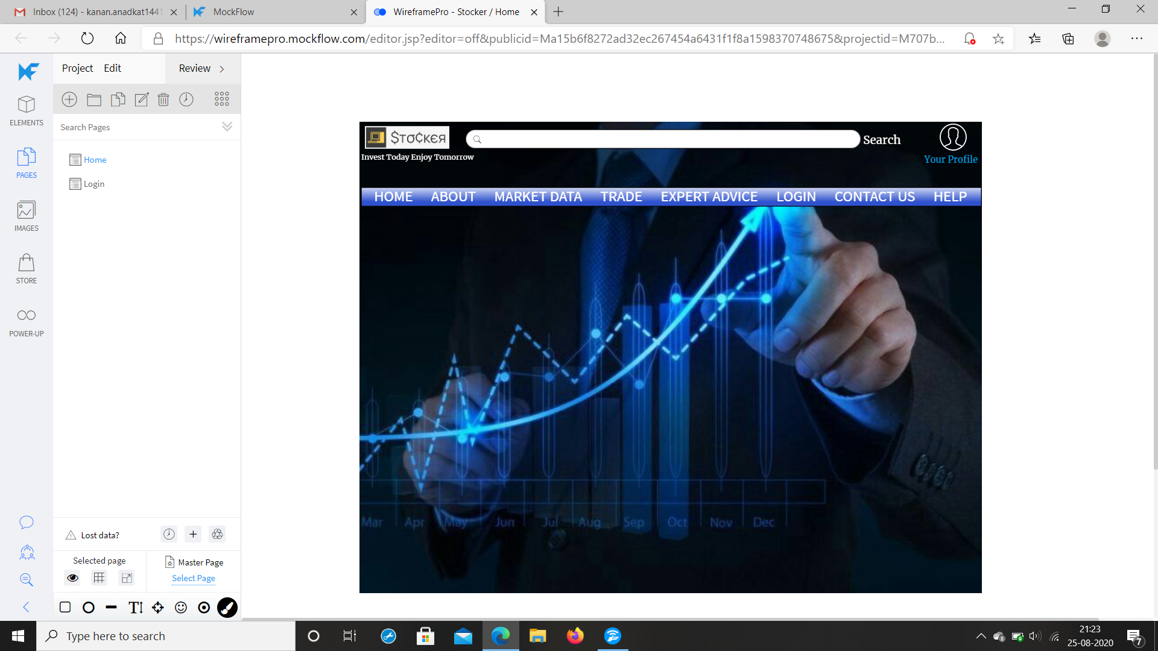
Home page

Slide 22
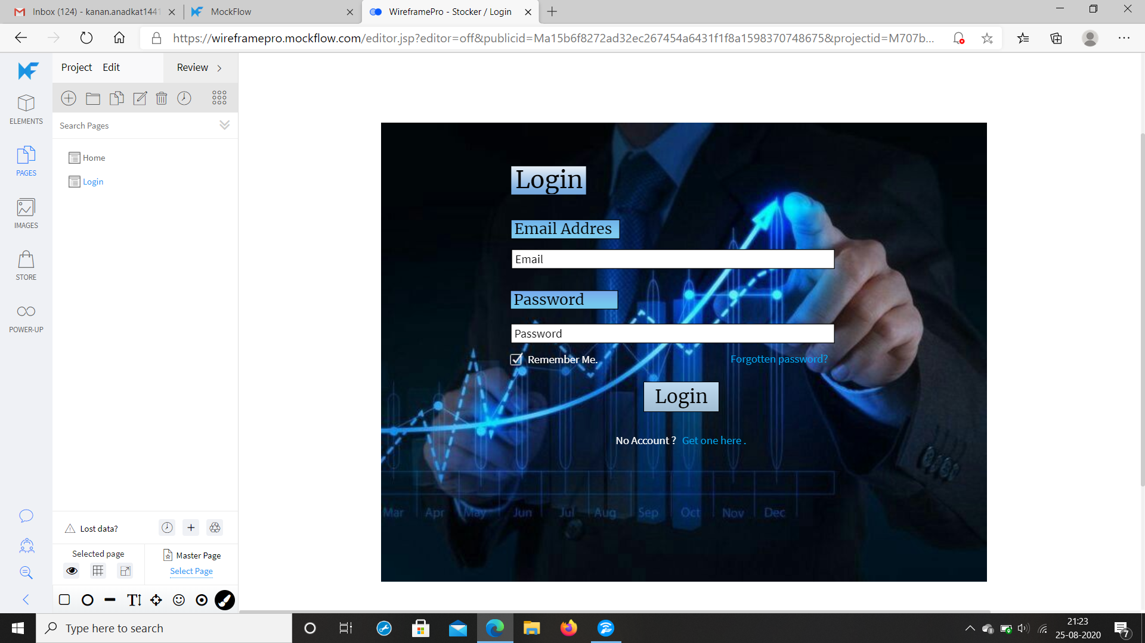
Login page

Slide 23
Design Engineering Canvas

Slide 24
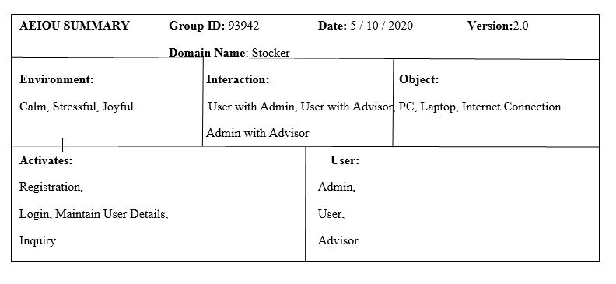
AEIOU

Slide 25
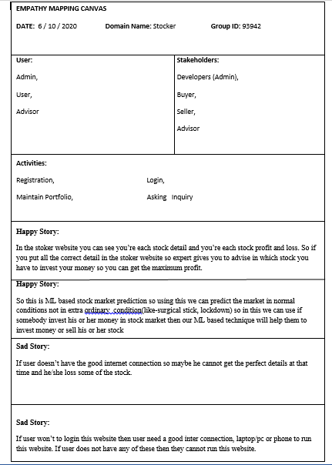
EMPATHY CANVAS

Slide 26
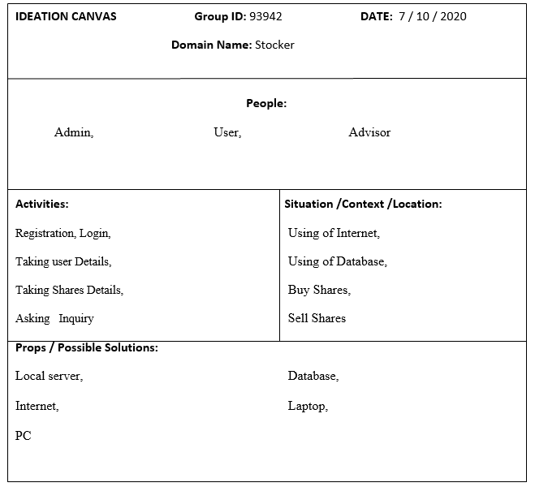
Ideation Canvas

Slide 27
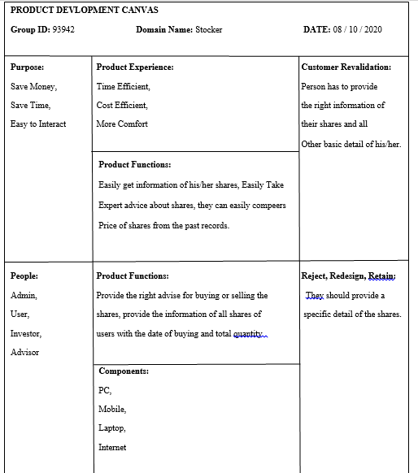
Product Development Canvas

Slide 28
Team
Kanan – 171160107002
She is working on the ML part and Django
Hetvi – 171160107018
She is working on frontend part(HTML,CSS,JS,Flask)
Pranav – 171160107029
He is working on documentation and all PSAR
Brijesh – 171160107052
He is also working of ML part and python

Slide 29
Thank you…

